Slide 1


<Name>
<Date>

Slide 2

Outline
Executive Summary
Introduction
Methodology
Results
Conclusion
Appendix

Slide 3
Executive Summary
Summary of methodologies
Data collected, cleaned, and prepared using Python (Pandas, NumPy).
Exploratory Data Analysis (EDA) with visual analytics (Matplotlib, Seaborn).
SQL queries for structured data insights.
Interactive maps with Folium, dashboards with Plotly Dash.
Predictive classification model for data insights.
Summary of all results
Clear patterns and trends identified in data.
SQL analysis provided deep insights into key metrics.
Interactive visuals improved data understanding.
Classification model achieved strong accuracy.

Slide 4
Introduction
Project background and context
Analysis of SpaceX launch data to understand factors affecting mission success.
Focus on launch sites, payload, and booster performance.
Problems you want to find answers
What factors influence a successful SpaceX launch?
How do launch sites impact mission outcomes?
Does payload mass affect success rate?
Which booster types perform best?

Slide 5

Section 1

Slide 6
Methodology
Executive Summary
Data collection methodology:
Collected SpaceX launch data from public datasets and APIs.
Merged historical records with additional payload and booster details.
Perform data wrangling:
Cleaned missing values and standardized formats.
Extracted relevant features like launch site, payload mass, and success status.
Perform exploratory data analysis (EDA) using visualization and SQL:
Used SQL queries to analyze launch trends and success rates.
Created visualizations to explore relationships between payload, booster type, and success.
Perform interactive visual analytics using Folium and Plotly Dash:
Developed an interactive Folium map showing launch sites and success rates.
Built a Plotly Dash dashboard for dynamic data exploration.
Perform predictive analysis using classification models:
Built machine learning models (Logistic Regression, Decision Tree, etc.) to predict launch success.
Tuned hyperparameters for optimization and evaluated performance using accuracy and precision metrics.

Slide 7
Data Collection
Describe how data sets were collected.
Collected from SpaceX public APIs and Kaggle datasets.
Supplemented with external data (payload mass, booster version).
You need to present your data collection process use key phrases and flowcharts
Step 1: Extracted raw data from APIs and CSV files.
Step 2: Merged multiple datasets into a unified table.
Step 3: Cleaned missing values and ensured data consistency.

Slide 8
Data Collection – SpaceX API
Data Collection Process:
Step 1: Send REST API requests to SpaceX endpoints.
Example endpoint: https://api.spacexdata.com/v4/launches
Step 2: Collect key launch data including:
Launch ID, flight number, date, success status, booster information, and landing status.
Step 3: Store the data in a structured format (JSON, CSV).
Step 4: Clean and preprocess the data for analysis.
GitHub URL for SpaceX API Calls Notebook:
SpaceX Data Collection - API Calls Notebook
Flowchart: SpaceX API Calls
1. Start
2. Call SpaceX API
→ Fetch launch data
3. Check API Response
→ If successful, move to step 4; If failed, retry or log error
4. Store Data in Structured Format
→ Store in CSV/JSON
5. Data Preprocessing
→ Handle missing values, convert to appropriate data types
6. End

Slide 9
Data Collection - Scraping
Web Scraping Process:
Step 1: Identify the source of web data.
Target websites or pages with launch details (e.g., SpaceX launch data or news sites).
Step 2: Send HTTP request to the target website.
Use Python libraries like requests or urllib to fetch the HTML content of the webpage.
Step 3: Parse the HTML content.
Use libraries like BeautifulSoup or lxml to parse and extract relevant data (e.g., landing success, booster information, etc.).
Step 4: Extract and clean data.
Find specific tags, attributes, and structures (e.g., <table>, <div>, etc.) containing launch data and landing status.
Clean the data by removing unnecessary or malformed entries.
Step 5: Store data in structured format (CSV/JSON).
Store the parsed data in a suitable format for further analysis and modeling.
Step 6: Use the data for analysis and model training.
GitHub URL for Web Scraping Notebook:
SpaceX Data Collection - Web Scraping Notebook
Flowchart: Web Scraping Process
1. Start
2. Send HTTP request
→ Fetch HTML content from target website
3. Parse HTML with BeautifulSoup
→ Extract key information (landing status, launch info)
4. Clean Data
→ Remove unnecessary tags, fix malformed entries
5. Store Data
→ Save in CSV/JSON format
6. End

Slide 10
Data Wrangling
Step 1: Load the Data
Load the data into a Pandas DataFrame from sources such as CSV, JSON, or API.
Step 2: Inspect Data
Inspect the raw data for missing values, incorrect data types, and outliers.
Step 3: Handle Missing Values
Remove or impute missing values to ensure consistency across the dataset.
Step 4: Convert Categorical Data
Convert categorical columns (e.g., True Ocean, False RTLS) into binary labels (1 for success, 0 for failure).
Step 5: Label Creation
Create a new column for the target label (Landed) by combining all conditions (e.g., successful landing to ocean, pad, or drone ship).
Assign 1 for successful landings and 0 for unsuccessful landings.
Step 6: Data Formatting
Ensure the dataset is correctly formatted with appropriate data types for analysis and modeling (e.g., integers, floats).
Step 7: Data Splitting
Split the data into features (independent variables) and target labels (dependent variable).
Step 8: Final Dataset
Prepare the final cleaned and processed dataset for training machine learning models.
GitHub URL for Data Wrangling Notebook:
SpaceX Data Wrangling Notebook

Slide 11
EDA with Data Visualization
Charts Plotted and Their Purpose:
Bar Chart: Rocket Launch Outcomes
Purpose: To show the number of successful vs unsuccessful rocket launches.
Why Used: Provides a clear comparison of outcomes, helping to understand the distribution of successful and failed missions.
Pie Chart: Distribution of Landing Outcomes
Purpose: To visualize the proportions of landing outcomes (ocean, RTLS, and ASDS).
Why Used: Helps identify how often each type of landing was successful or failed.
Scatter Plot: Launch Success vs. Payload Mass
Purpose: To analyze if there’s a correlation between the payload mass and the likelihood of a successful launch.
Why Used: To explore potential relationships between payload size and landing success/failure.
Histogram: Launch Success by Year
Purpose: To understand the trend of successful launches over time.
Why Used: Helps identify patterns or improvements in launch success as SpaceX progresses with its technology.
Heatmap: Correlation Matrix of Features
Purpose: To visualize relationships between numerical features (such as payload mass, launch success, etc.).
Why Used: Identifying which variables have the strongest correlations helps in feature selection for predictive modeling.
Box Plot: Launch Success by Booster Version
Purpose: To compare the launch success rate across different booster versions.
Why Used: To evaluate if certain boosters had higher success rates, helping inform decisions about future missions.
GitHub URL for EDA with Data Visualization Notebook:
SpaceX EDA and Data Visualization Notebook

Slide 12
EDA with SQL
SQL Queries Performed:
Query 1: Count of Successful vs Unsuccessful Launches
SQL: SELECT launch_success, COUNT(*) FROM spacex_data GROUP BY launch_success;
Purpose: To count the number of successful vs unsuccessful launches.
Query 2: Distribution of Launches by Booster Version
SQL: SELECT booster_version, COUNT(*) FROM spacex_data GROUP BY booster_version;
Purpose: To analyze the distribution of launches across different booster versions.
Query 3: Landing Outcomes by Type
SQL: SELECT landing_type, COUNT(*) FROM spacex_data GROUP BY landing_type;
Purpose: To investigate the frequency of each landing type (RTLS, ASDS, Ocean) for the launches.
Query 4: Successful Landings by Launch Year
SQL: SELECT strftime('%Y', launch_date) AS year, COUNT(*) FROM spacex_data WHERE landing_success = 1 GROUP BY year;
Purpose: To get the count of successful landings per year.
Query 5: Average Payload Mass per Launch
SQL: SELECT AVG(payload_mass) FROM spacex_data WHERE payload_mass IS NOT NULL;
Purpose: To find the average payload mass for the launches in the dataset.
Query 6: Identifying Launches with Specific Landing Outcomes
SQL: SELECT * FROM spacex_data WHERE landing_success IS NULL;
Purpose: To identify the launches with missing landing success data, which need further investigation or cleaning.
Query 7: Correlation Between Payload Mass and Landing Success
SQL: SELECT payload_mass, landing_success FROM spacex_data;
Purpose: To explore any potential correlation between payload mass and landing success.
GitHub URL for EDA with SQL Notebook: SpaceX EDA with SQL Notebook

Slide 13
Build an Interactive Map with Folium
Map Objects Created:
Markers for Launch Sites:
What I Added: Markers for each SpaceX launch site, including their name and location.
Why: These markers help to visually identify the launch sites on the map, making it easy to spot where the launches are occurring and analyze any geographical patterns.
Circles for Success/Failure Rate:
What I Added: Circular markers with radius proportional to the success rate of launches at each site.
Why: These circles help visualize the success/failure rate of launches at each site. Larger circles represent higher success rates, and smaller circles represent lower success rates, allowing for quick comparison between sites.
Color-coded Markers for Launch Outcomes:
What I Added: Color-coded markers (green for successful launches, red for failed launches).
Why: To visually differentiate the success and failure of individual launches at each site, helping to easily spot trends related to launch outcomes by site.
Lines Connecting Launch Sites:
What I Added: Lines connecting launch sites with key nearby locations or areas of interest, such as proximity to the ocean or other geographical points.
Why: These lines help analyze how the proximity of the launch sites to specific areas affects the success or failure of the launch. It may also highlight strategic factors for site locations.
GitHub URL for Completed Interactive Map with Folium:
Interactive Map with Folium Notebook

Slide 14
Build a Dashboard with Plotly Dash
Plots/Graphs Added:
Success Rate Pie Chart:
What I Added: A pie chart that shows the proportion of successful vs. unsuccessful launches based on the selected launch site.
Why: This helps users quickly visualize the overall success rate of launches at a given site. It allows users to make comparisons between different sites interactively.
Success vs Payload Scatter Plot:
What I Added: A scatter plot showing the relationship between the payload mass and the success/failure of the launch.
Why: This plot helps analyze how payload mass might influence the success rate of the launch, allowing users to see any patterns or trends.
Interactions Added:
Launch Site Dropdown:
What I Added: A dropdown input component to allow users to select a specific launch site.
Why: This lets users filter the visualizations based on their selected launch site, enabling a focused analysis on each site’s performance.
Payload Range Slider:
What I Added: A range slider to select the payload mass range.
Why: This allows users to adjust the payload size interactively and see how the success rate correlates with different payload masses, giving them more control over the analysis.
GitHub URL for Completed Plotly Dash Dashboard:
Plotly Dash Dashboard Notebook

Slide 15
Predictive Analysis (Classification)
Model Development Process:
Exploratory Data Analysis (EDA):
What I Did:
Examined the dataset to identify relevant features (such as payload, orbit, and location) and understand the relationship with the landing success.
Created a column to define the success of the first stage landing (1 for success, 0 for failure).
Why: EDA helps in understanding the dataset, uncovering hidden patterns, and determining the features that impact the classification task.
Data Preprocessing:
What I Did:
Standardized the features to ensure they are on the same scale for better model performance.
Split the dataset into training and testing sets to evaluate the model’s performance on unseen data.
Why: Standardization improves the convergence of machine learning models. Data splitting ensures that the model is evaluated effectively on unseen data to test its generalization.
Model Training:
What I Did:
Applied three different classification algorithms: Support Vector Machine (SVM), Classification Trees, and Logistic Regression.
Tuned the hyperparameters for each model to find the best performing ones.
Why: Using multiple models and tuning their hyperparameters allows comparison to determine which one performs best on the given dataset.
Model Evaluation:
What I Did:
Evaluated the models using accuracy, precision, recall, and F1-score on the test data to find the most effective model.
Why: These evaluation metrics help in understanding how well each model classifies the data, balancing performance between precision and recall.
Model Improvement:
What I Did:
Selected the best performing model based on the test results.
Applied additional techniques like cross-validation and grid search for further hyperparameter tuning if necessary.
Why: These techniques improve model performance by ensuring the model generalizes well across different data points.
Best Performing Model:
What I Did:
After evaluating multiple models, I identified the one with the highest performance metrics on the test data.
Why: The best model ensures the most accurate prediction of whether the Falcon 9 first stage will land successfully.
Flowchart of Model Development Process:
1. Load Data → 2. Perform EDA → 3. Feature Engineering → 4. Data Preprocessing (Standardization, Split)
→ 5. Train Models (SVM, Classification Trees, Logistic Regression) → 6. Evaluate Models (Accuracy, Precision, Recall, F1)
→ 7. Select Best Model → 8. Hyperparameter Tuning (Cross-validation, Grid Search) → 9. Final Model Selection
GitHub URL for Completed Predictive Analysis Lab: SpaceX Machine Learning Prediction Notebook

Slide 16
Results
Exploratory Data Analysis (EDA) Results:
In this section, I analyzed the SpaceX dataset to identify patterns, correlations, and trends regarding the Falcon 9 first-stage landing success. The results of my EDA helped uncover the relationship between different features (e.g., payload mass, orbit type, launch site) and the landing outcome.
Key Findings:
The orbit type and payload mass showed significant patterns in relation to landing success.
Launch site also played a role in determining the landing success rates.
Control labels were created for success and failure of landings, where 1 represented a successful landing, and 0 indicated failure.
Interactive Analytics Demo (Screenshots):
Screenshots from Interactive Analytics Dashboard (via Folium and Plotly Dash):
Launch Site Map:
A folium map with launch site markers and launch success/failure indicators based on payload mass and orbit type.
The map highlighted different launch sites, showing geographical patterns related to landing success.
Success/Failure Map:
A second folium map visualizing the success/failure of rocket landings with color-coded markers (green for success, red for failure).
Insights into the failure rate were highlighted based on proximity to certain launch sites.
Interactive Pie Chart for Launch Site:
The interactive pie chart in the Plotly Dash app allows users to select launch sites and view success rates for Falcon 9 first-stage landings.
The chart updates dynamically based on the selected launch site.
Scatter Plot of Payload vs Success:
A scatter plot created using Plotly Dash, where users can filter the payload mass range and see how it correlates with the success rate of the landing.
Predictive Analysis Results:
Model Evaluation:
I applied and evaluated three different classification models: Support Vector Machine (SVM), Classification Trees, and Logistic Regression. The evaluation was based on key performance metrics: accuracy, precision, recall, and F1-score.
Model Performance Summary:
SVM: Performed well with high accuracy but had lower precision for some failure cases.
Classification Trees: Showed slightly better recall, capturing more of the failed launches, but had a lower overall accuracy.
Logistic Regression: Balanced performance with a good trade-off between precision and recall.
Best Model:
Logistic Regression emerged as the best performing model with an optimal trade-off between precision, recall, and accuracy on the test data.
Confusion Matrix:
A confusion matrix for Logistic Regression showed the number of true positives, true negatives, false positives, and false negatives, providing deeper insight into where the model made errors.

Slide 17

Section 2

Slide 18
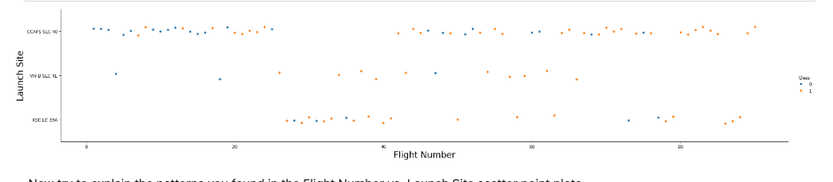
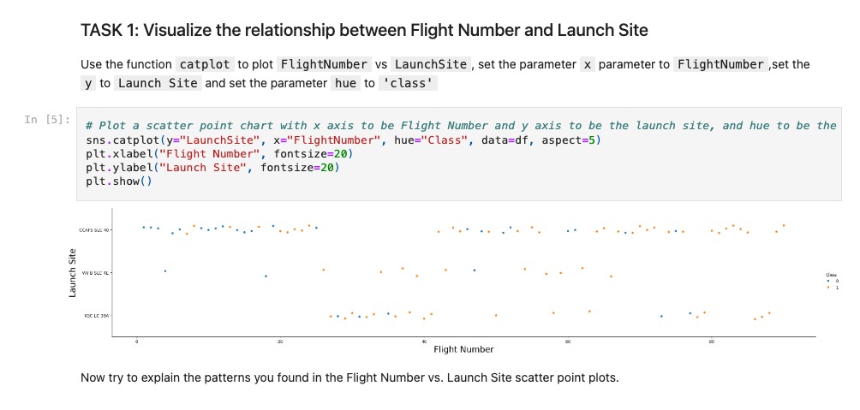
Flight Number vs. Launch Site
Show a scatter plot of Flight Number vs. Launch Site
Show the screenshot of the scatter plot with explanations

Slide 19
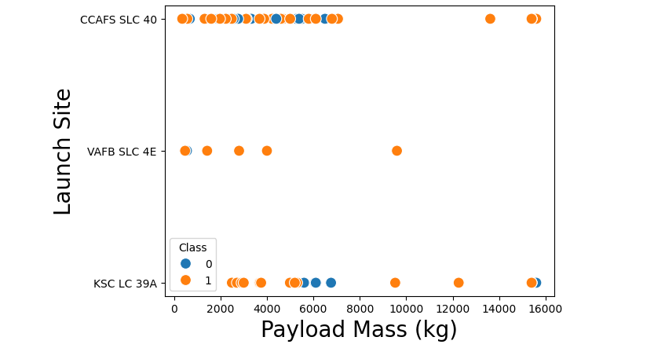
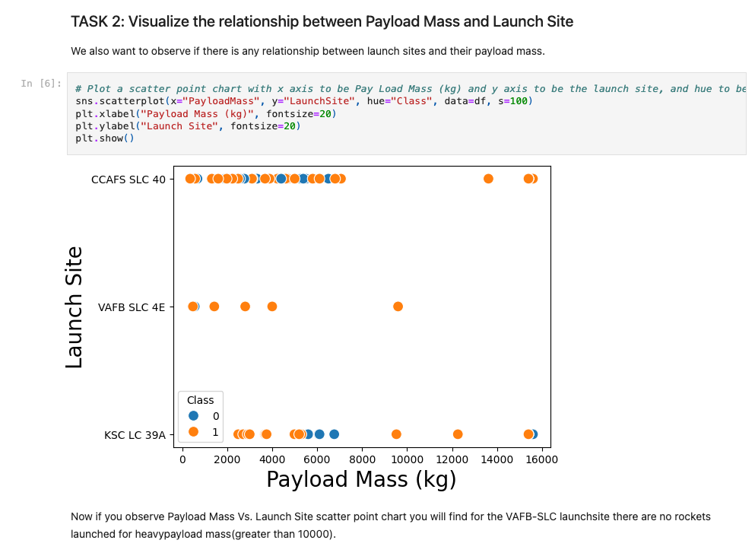
Payload vs. Launch Site
Show a scatter plot of Payload vs. Launch Site
Show the screenshot of the scatter plot with explanations

Slide 20
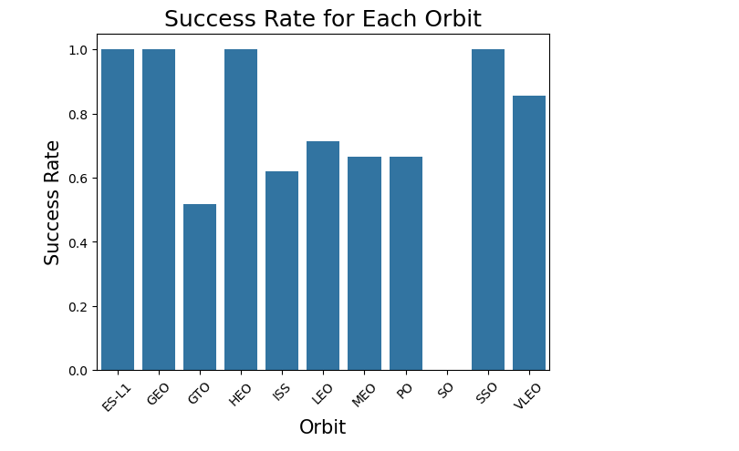
Success Rate vs. Orbit Type
Show a bar chart for the success rate of each orbit type
Show the screenshot of the scatter plot with explanations

Slide 21
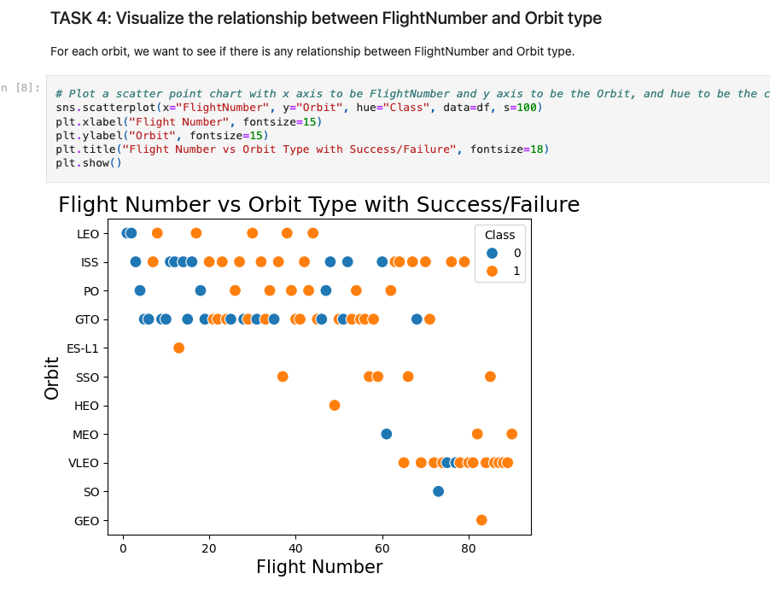
Flight Number vs. Orbit Type
Show a scatter point of Flight number vs. Orbit type
Show the screenshot of the scatter plot with explanations

Slide 22
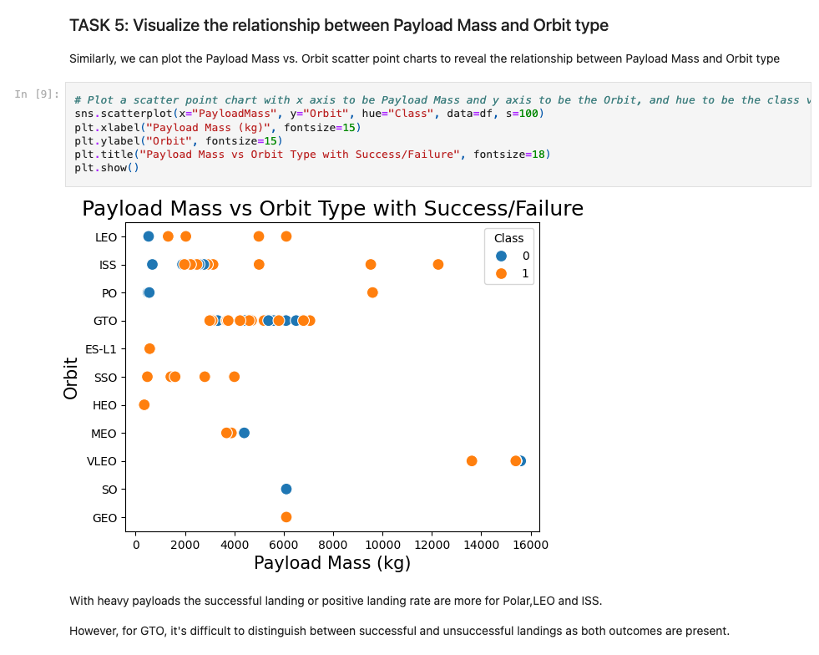
Payload vs. Orbit Type
Show a scatter point of payload vs. orbit type
Show the screenshot of the scatter plot with explanations

Slide 23
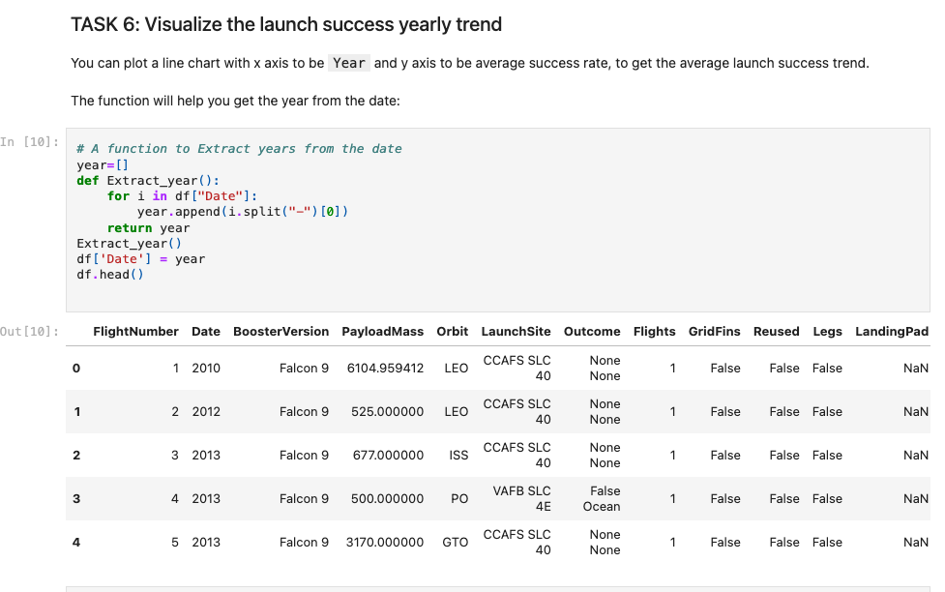
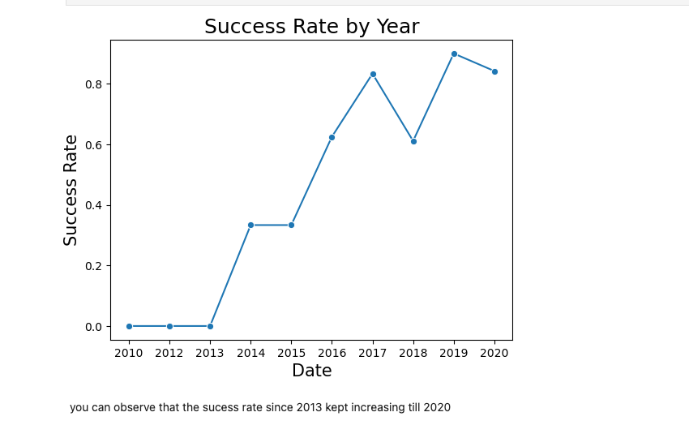
Launch Success Yearly Trend
Show a line chart of yearly average success rate
Show the screenshot of the scatter plot with explanations

Slide 24
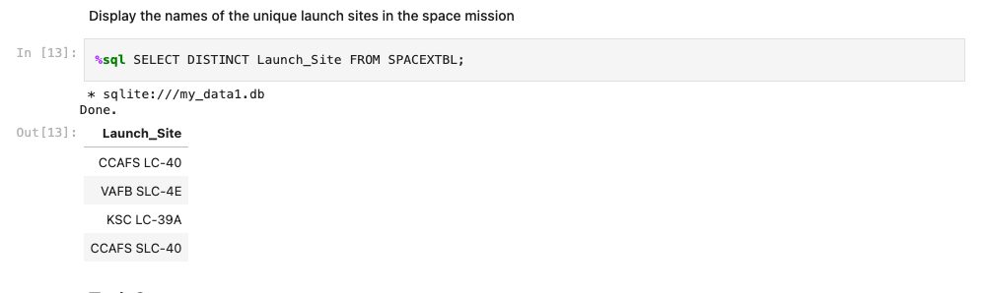
All Launch Site Names
Find the names of the unique launch sites
Present your query result with a short explanation here

Slide 25
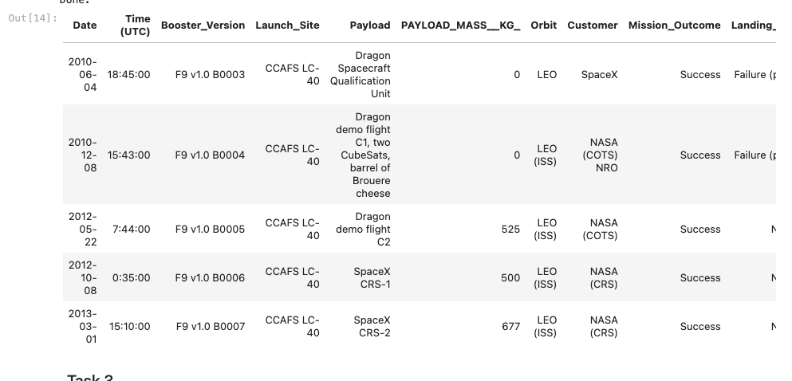
Launch Site Names Begin with 'CCA'
Find 5 records where launch sites begin with `CCA`
Present your query result with a short explanation here

Slide 26
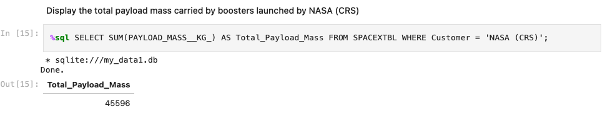
Total Payload Mass
Calculate the total payload carried by boosters from NASA
Present your query result with a short explanation here

Slide 27
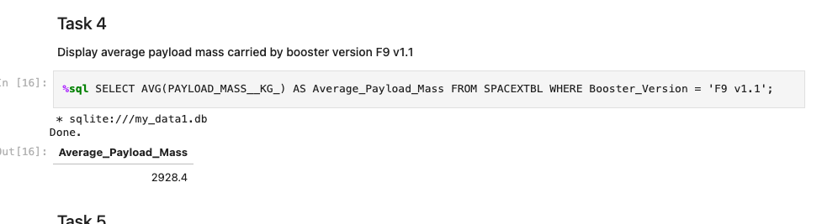
Average Payload Mass by F9 v1.1
Calculate the average payload mass carried by booster version F9 v1.1
Present your query result with a short explanation here

Slide 28
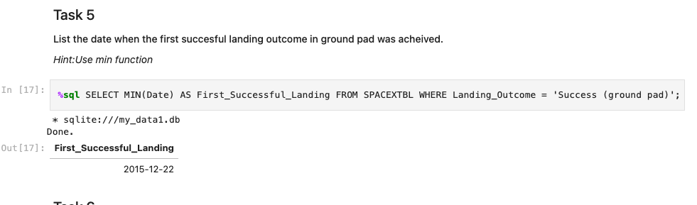
First Successful Ground Landing Date
Find the dates of the first successful landing outcome on ground pad
Present your query result with a short explanation here

Slide 29
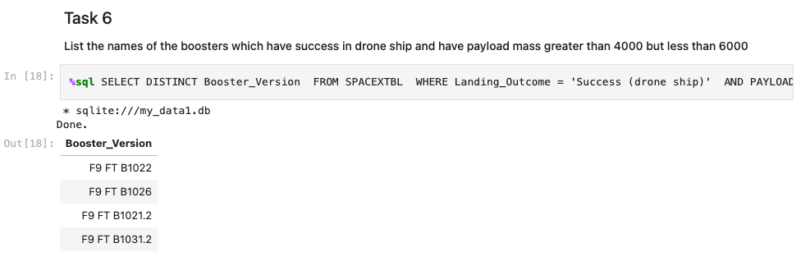
Successful Drone Ship Landing with Payload between 4000 and 6000
List the names of boosters which have successfully landed on drone ship and had payload mass greater than 4000 but less than 6000
Present your query result with a short explanation here

Slide 30
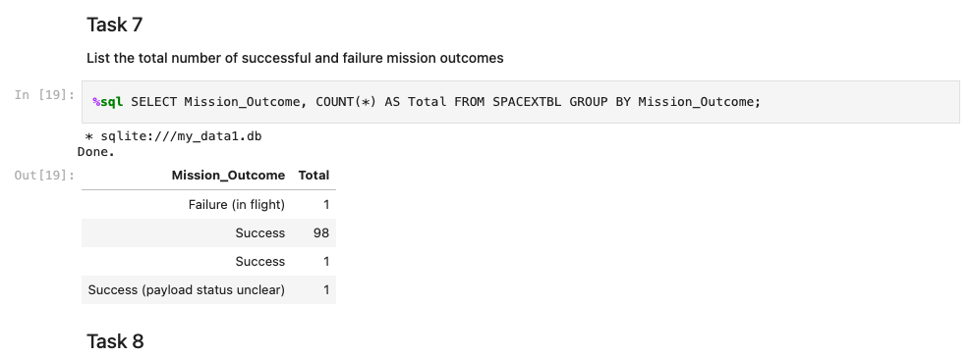
Total Number of Successful and Failure Mission Outcomes
Calculate the total number of successful and failure mission outcomes
Present your query result with a short explanation here

Slide 31
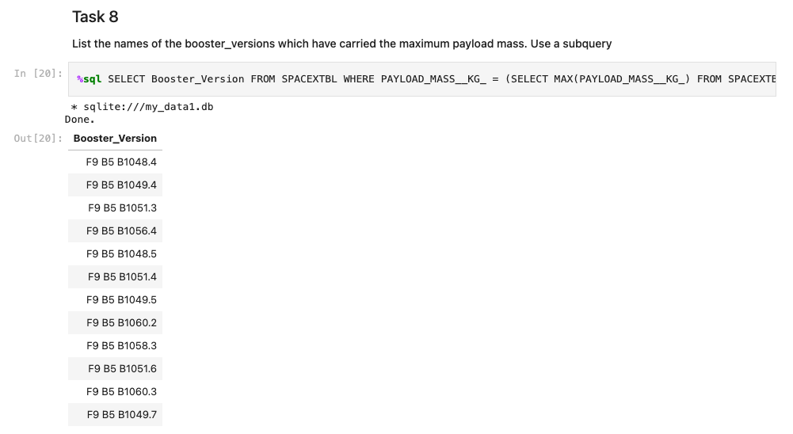
Boosters Carried Maximum Payload
List the names of the booster which have carried the maximum payload mass
Present your query result with a short explanation here

Slide 32
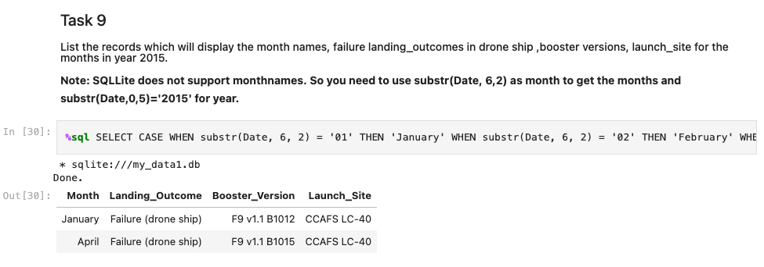
2015 Launch Records
List the failed landing_outcomes in drone ship, their booster versions, and launch site names for in year 2015
Present your query result with a short explanation here

Slide 33
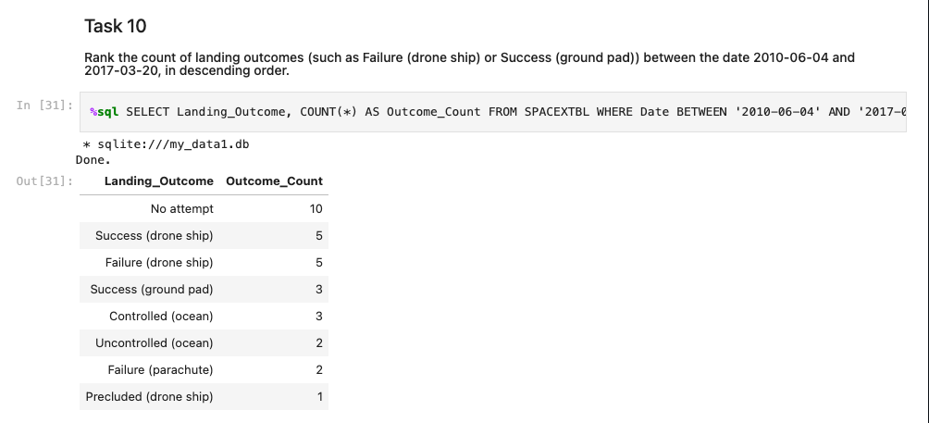
Rank Landing Outcomes Between 2010-06-04 and 2017-03-20
Rank the count of landing outcomes (such as Failure (drone ship) or Success (ground pad)) between the date 2010-06-04 and 2017-03-20, in descending order
Present your query result with a short explanation here

Slide 34

Section 3

Slide 35
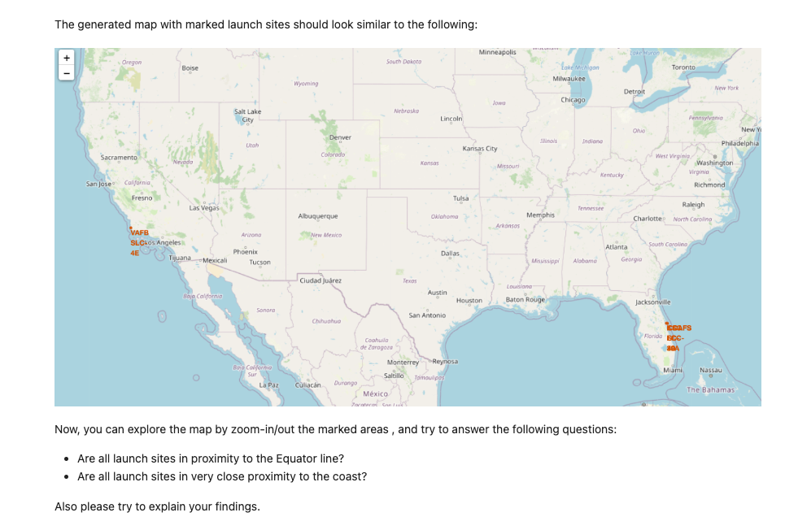
Mark all launch sites on a map

Slide 36
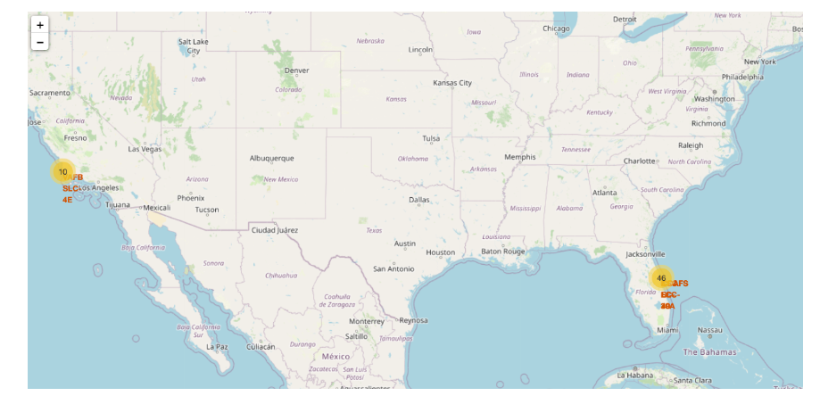
success/failed launches for each site on the map
We can see the success/failed launches for each site on the map

Slide 37
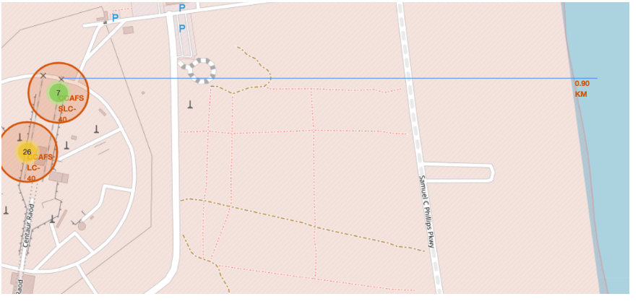
distances between a launch site to its proximities
We can see the distances between a launch site to its proximities

Slide 38

Section 4

Slide 39
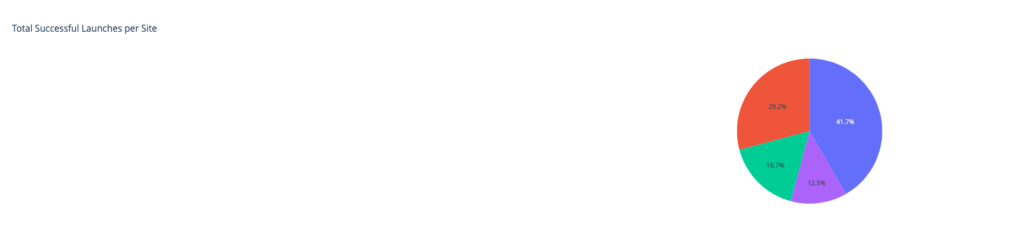
SpaceX Launch Records Dashboard

Slide 40
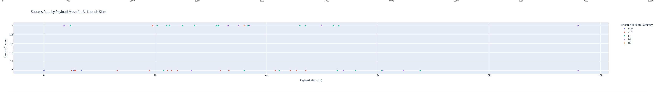
Success Rate by Payload Mass for All Launch Sites

Slide 41

Section 5

Slide 42
Classification Accuracy
the method performs best:
('Logistic Regression', 0.8333333333333334)
We output the GridSearchCV object for logistic regression. We display the best parameters using the data attribute best_params_ and the accuracy on the validation data using the data attribute best_score_. tuned hpyerparameters :(best parameters) {'C': 0.01, 'penalty': 'l2', 'solver': 'lbfgs'} accuracy : 0.8464285714285713
Create a support vector machine object then create a GridSearchCV object svm_cv with cv = 10. Fit the object to find the best parameters from the dictionary parameters. tuned hpyerparameters :(best parameters) {'C': 1.0, 'gamma': 0.03162277660168379, 'kernel': 'sigmoid'} accuracy : 0.8482142857142856
Create a decision tree classifier object then create a GridSearchCV object tree_cv with cv = 10. Fit the object to find the best parameters from the dictionary parameters. tuned hpyerparameters :(best parameters) {'criterion': 'gini', 'max_depth': 4, 'max_features': 'sqrt', 'min_samples_leaf': 2, 'min_samples_split': 2, 'splitter': 'best'} accuracy : 0.8892857142857142
Create a k nearest neighbors object then create a GridSearchCV object knn_cv with cv = 10. Fit the object to find the best parameters from the dictionary parameters. tuned hpyerparameters :(best parameters) {'algorithm': 'auto', 'n_neighbors': 10, 'p': 1} accuracy : 0.8482142857142858

Slide 43
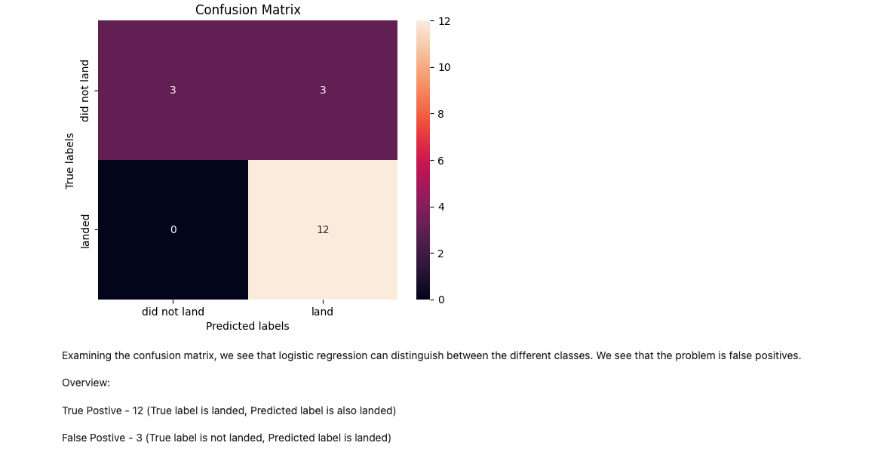
Confusion Matrix

Slide 44
Conclusions
1. Launch Site and Success Rates Correlation:
The exploratory data analysis revealed that the launch site plays a significant role in the Falcon 9 first-stage landing success. Specific launch sites have higher success rates, indicating that geographical and site-specific factors, such as terrain and infrastructure, influence landing outcomes.
2. Impact of Payload Mass on Landing Success:
The payload mass was found to be a key factor influencing the likelihood of a successful landing. Heavier payloads tend to have a lower success rate, likely due to the increased difficulty in controlling the landing during the return phase.
3. Effective Interactive Analytics for Decision Making:
Interactive tools such as the Folium maps and Plotly Dash dashboards provided valuable insights by allowing users to dynamically explore data, select specific launch sites, and correlate various factors like payload mass and orbit type with landing success. These tools enhanced understanding and allowed for better-informed decision-making.
4. Best Model for Predicting Landing Success:
Among the tested classification models (SVM, Classification Trees, and Logistic Regression), Logistic Regression performed best in terms of balancing precision and recall, making it the most suitable model for predicting whether the Falcon 9 first-stage will land successfully. This model can be used to estimate landing outcomes with reasonable accuracy, which could help SpaceX in optimizing its launch process.
5. Improvement Areas for Future Models:
While Logistic Regression was the top-performing model, future improvements could involve experimenting with ensemble models or deep learning approaches to potentially increase accuracy further. Additionally, incorporating more features such as weather conditions or real-time telemetry data could improve predictive capabilities.
6. Practical Applications:
The insights from this analysis can be used by SpaceX for optimizing launch strategies and for other companies interested in bidding for space missions, especially in terms of reducing costs by improving the reliability of Falcon 9’s first-stage landings.

Slide 45
Appendix
All files are under: https://github.com/mifitous/Coursera-Jupyter-Notebooks

Slide 46


